Slide 1

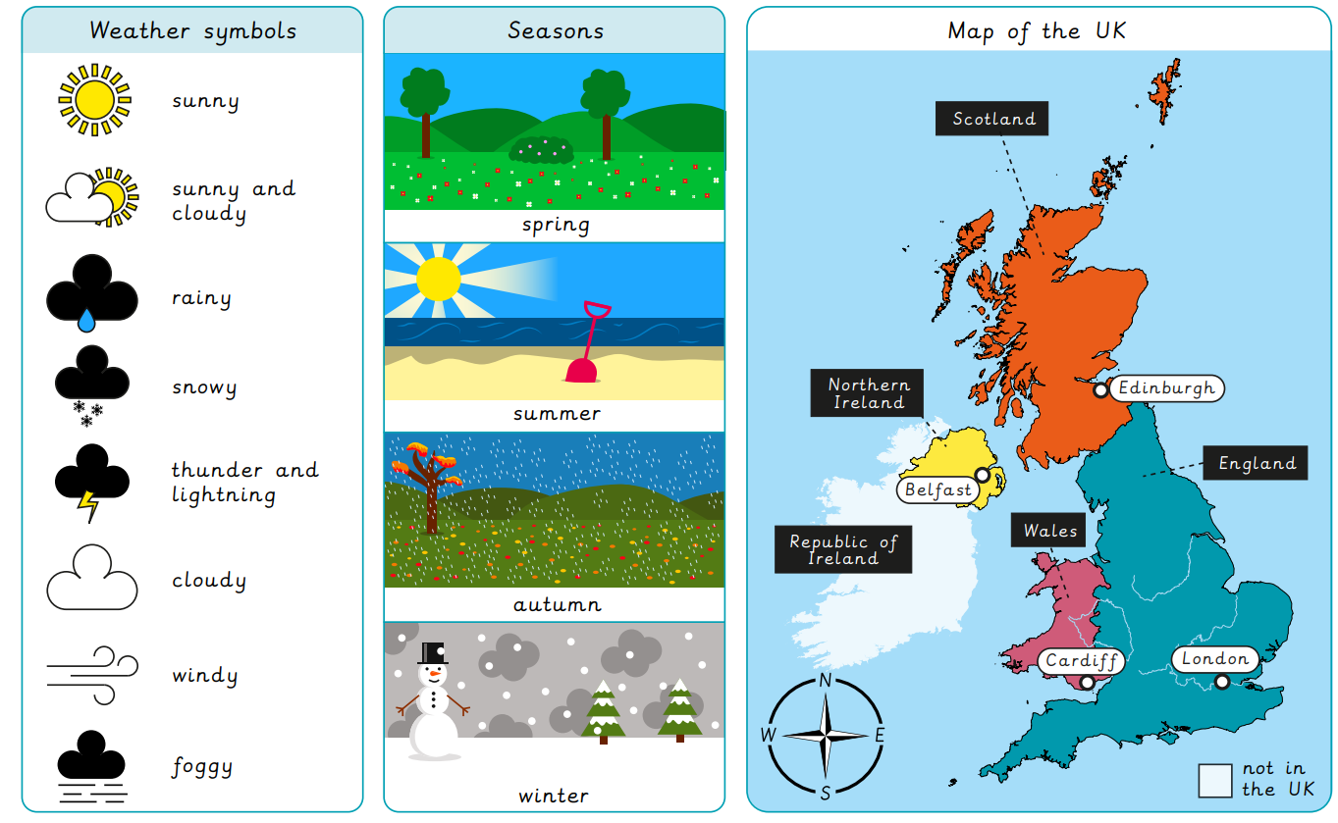
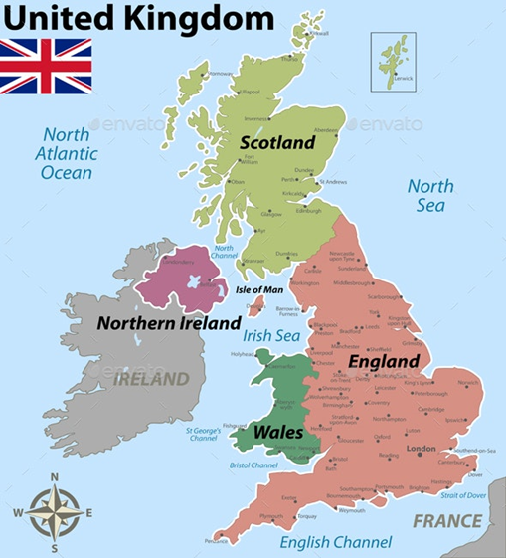
St Peter’s Catholic Primary School
Year 1 Geography – What is the Weather Like in the UK?
At the end of this topic, I will know:
Name, locate and identify characteristics of the 4 UK countries.
Use world maps, atlases and globes to identify the UK and its countries.
Use compass directions: North, East, South and West.
Describe seasonal weather changes.
Key Facts:
The UK is made up of 4 countries – England, Scotland, Wales and Northern Ireland.
The capital city of the United Kingdom is London.
The primary language spoken in the United Kingdom is English

